Slide 1

Mid-Bootcamp Project
Jorien Caron - September 2021

Slide 2

What member features predict a loan default?
Notes:
That brings us to the research question for the LC.

Slide 3
Loan Defaults
Notes:
Let’s have a small introduction on loan defaults. Because like most of you I also had no idea what a default at this time last week. But it’s actually quite straightforward. Let’s have a look!

Slide 4
Defaults?
What? | Why?
Phenomenon in loans no longer a reasonable expectation of further payments Usually after 120 days of no payment | Reduce financial loss Improve investors’ trust Improve investment decisions
Notes:
Defaults are a phenomenon that occur in the world of loans! It’s actually defined as the situation where there is no longer a reasonable expectation for any further payments, aka the money is gone. This usually occurs after 120 days of non-payment. The main instances dealing with these problems are banks, like ING, Credit Card(visa), and FinTech company. So why would we want to know if someone is going to default before hand?
First of all, the most straightforward one, we can reduce financial loss. For example, if someone defaults on a loan of 20.000 dollars this is quite some money to lose. Also, to improve trust, if you give that money out it would be nice to go to bed at night with the idea you will see your money get back
Also, knowing who is going to default will improve the pace with what an investor can make decisions and also the reliabilty of that choice.

Slide 5



What is the LendingClub?
A US based platform that takes the banker out of banking
Peer-to-Peer lending
Loan for any purpose
Beneficial Interest rates
Notes:
As just mentioned, FinTechs also struggle with defaults and are constantly trying to find ways to reduce this risk. One of these companies is LC.
This fintech is:
well basically a platform….
It’s has P2P where two individuals can help each other by borrowing and investing money.
Borrowers can apply for a loan by sending in their income, previous credit score, home situation, purpose of the loan etc
Investors can already invest in a loan for as little as a 1000 dollars
Members can apply for all sort of loans, like a wedding a holidy or the most popular option debt consolidation
Other than the easy accesibility of loans via the platform the interest rates are beneficial for both parties.
Interest rates for borrowers are lower than with a bank of credit card
for investors an easy way to earn money on not being dependent on the performance of for example a stock market.

Slide 6
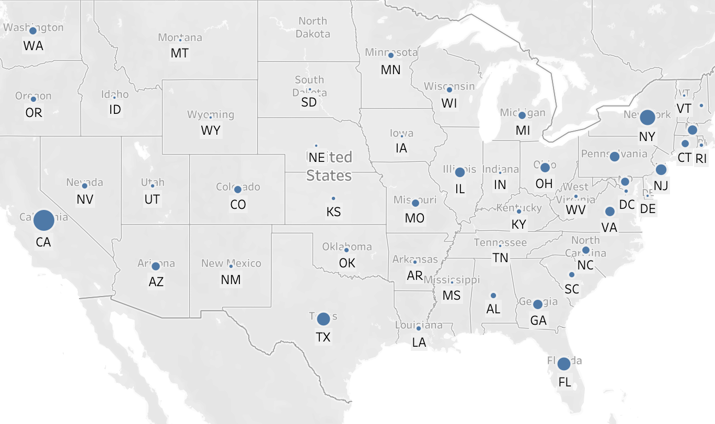




What is the LendingClub?
HQ in SF, US
42367
$446.190.100
$11.250
Notes:
The LendingClub is founded in San Francisco and has a total of 42367 members across the States. With the majority in California, New York, Florida and Texas. In this dataset the sum of the loans given out is 446… and the average loan value is 11.250 dollars

Slide 7
What are the risks?
No collateral
Lower fixed rates
No Prepayment fees
Loans are unsecured
Loss of personal funds
Multiple investors in one loan
Notes:
Let’s dive a bit deeper into the actual loan features. Although the platform is promising with beneficial rates for both sides there are also big risks associated with investing in the LC and giving someone a loan.
-Talk about risks -
Loss of reputation and investor’s trust in the platform. Especially if there is no bank you can complain to to get your money back and multiple investors who will have trouble if one person goes on and default. Especially platforms based on technology where big amounts of (personal) money are involved, LC has to make sure both sides trust the process and investors have to believe they will get their money back, elseway it is a quick exit.
Especially on a platform where trust is the main driver, LC should do everything in its power to decrease the amount of defaulted loans.

Slide 8
Find the defaulter
Notes:
So let’s have a look at the features that we have found to influence loan defaults

Slide 9
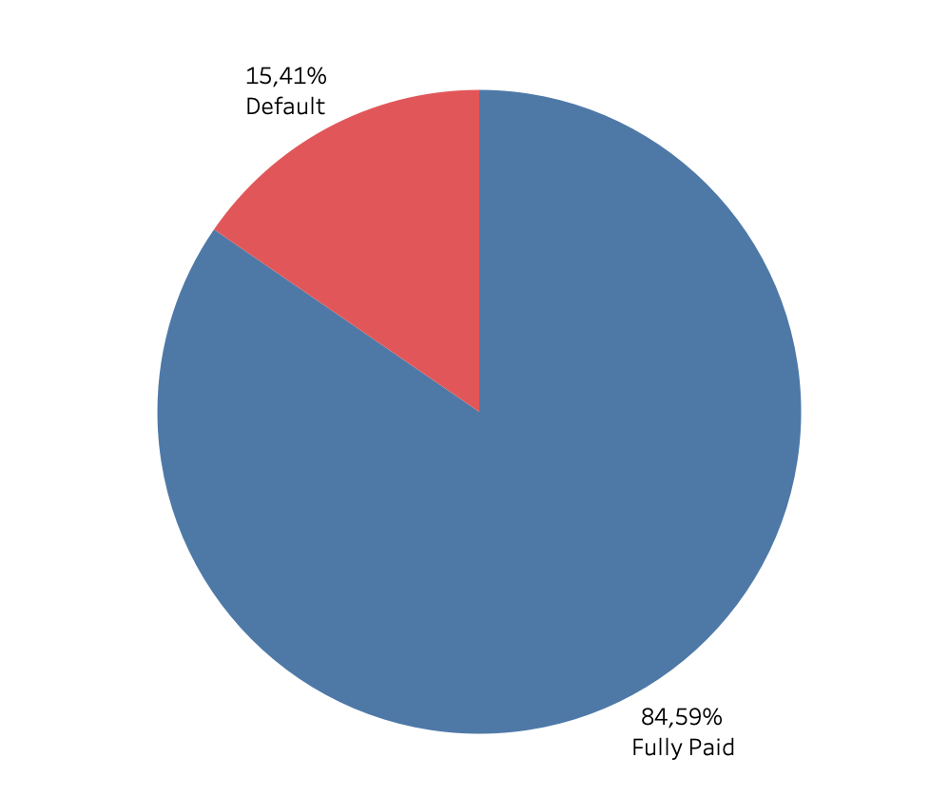
Default Ratio
Total loans: 39.746
Notes:
We can see LC is doing pretty good with a pretty low percentage of defaulters, however given that the average of defaulters in the US is 3% percent, LC should have a look at getting this number down.
although lending club doesn’t physically loses money when a loan defaults they do lose trust of investors in the platform and risk reputation issues. Especially on a platform where trust is the main driver, LC should do everything in its power to decrease the amount of defaulted loans.

Slide 10
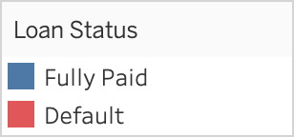
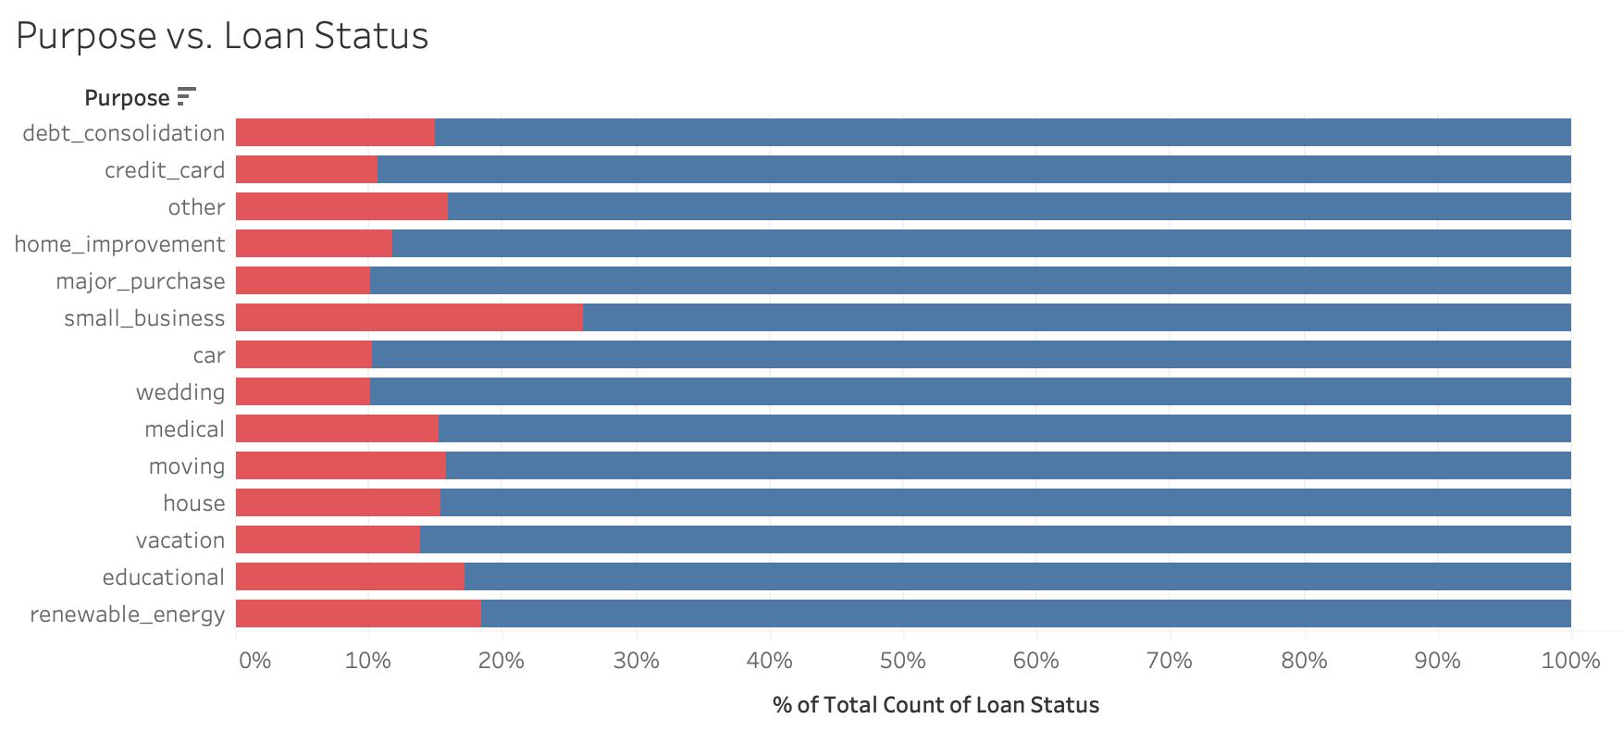
Default ratios
Defaults?
Small business
Notes:
Looking at the purpose of the loans, we can see that small business most often default on their loans.

Slide 11
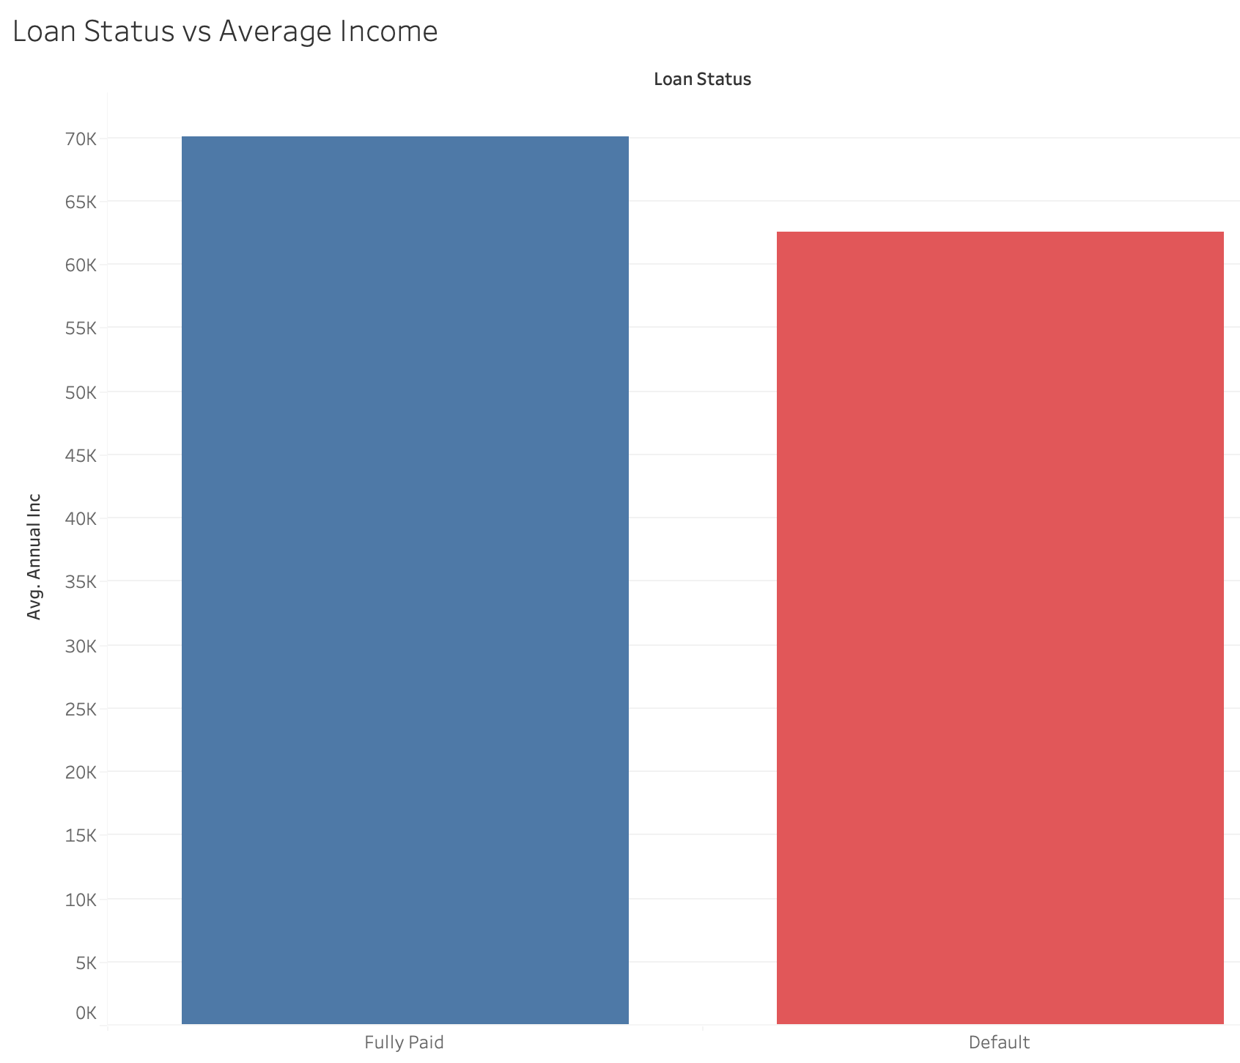
Default ratios
Notes:
Defaulters have on average a loan amount of 12K which is a 1000 dollars lower than the fully paid loans.
Also income is on average 8K lower than the ones of the loans that are being payed in time.

Slide 12
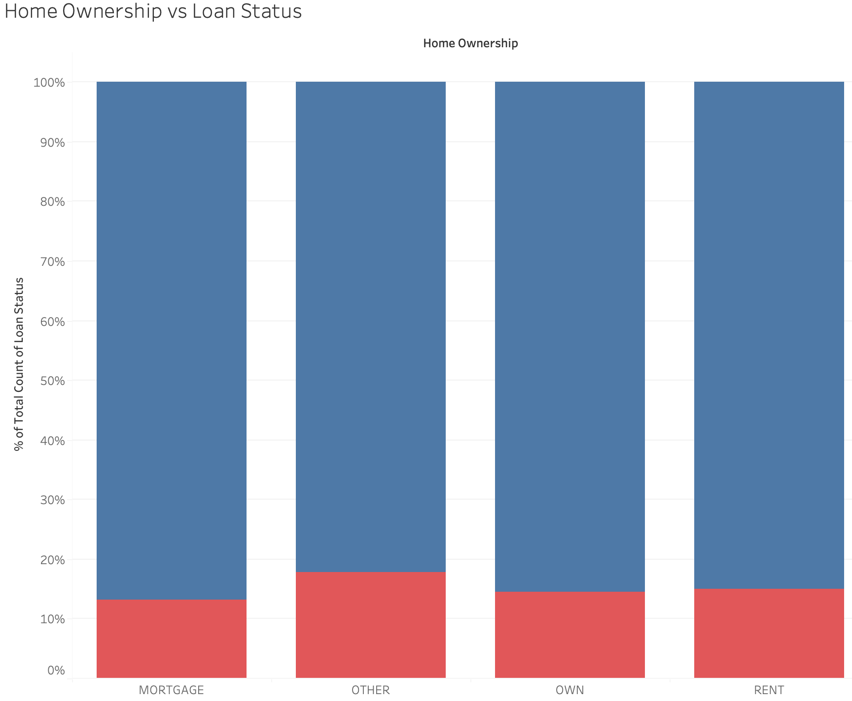
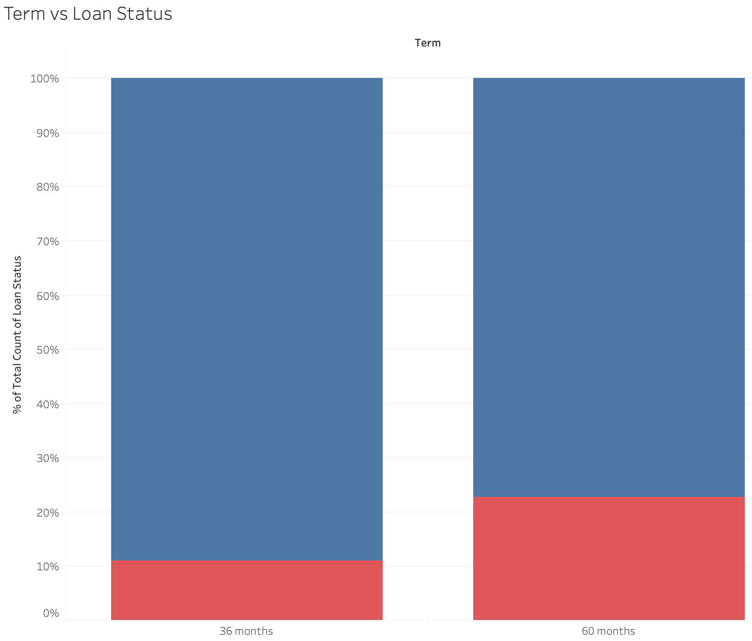
Default ratios
Notes:
Let’s have a look at home ownership and the term on which a loan should be repaid.
Although the differences are small we can see that the people who do not own a house, have mortgage or rent a house are more likely to default.
Also loans with a longer term are more likely to default.

Slide 13
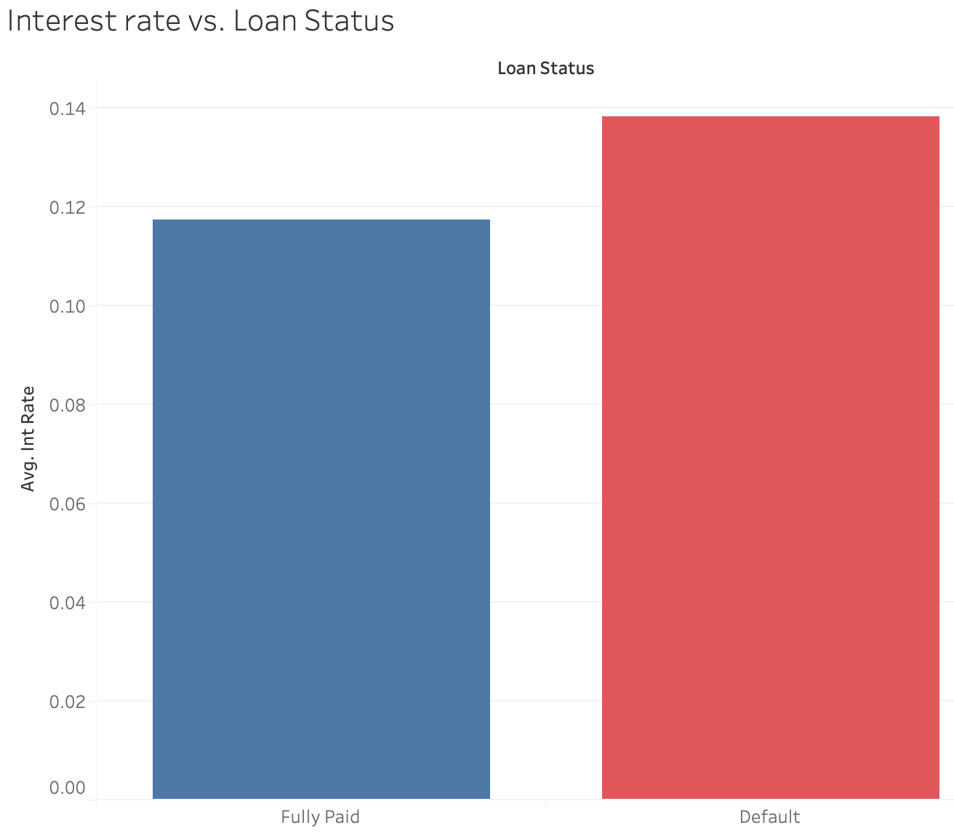
Default ratios
Notes:
Interest rates (so the interest a member has to pay every month to be able to get the loan on top of the monthly payments) on loans that are going to default are on average 2% higher than on fully paid loans.

Slide 14
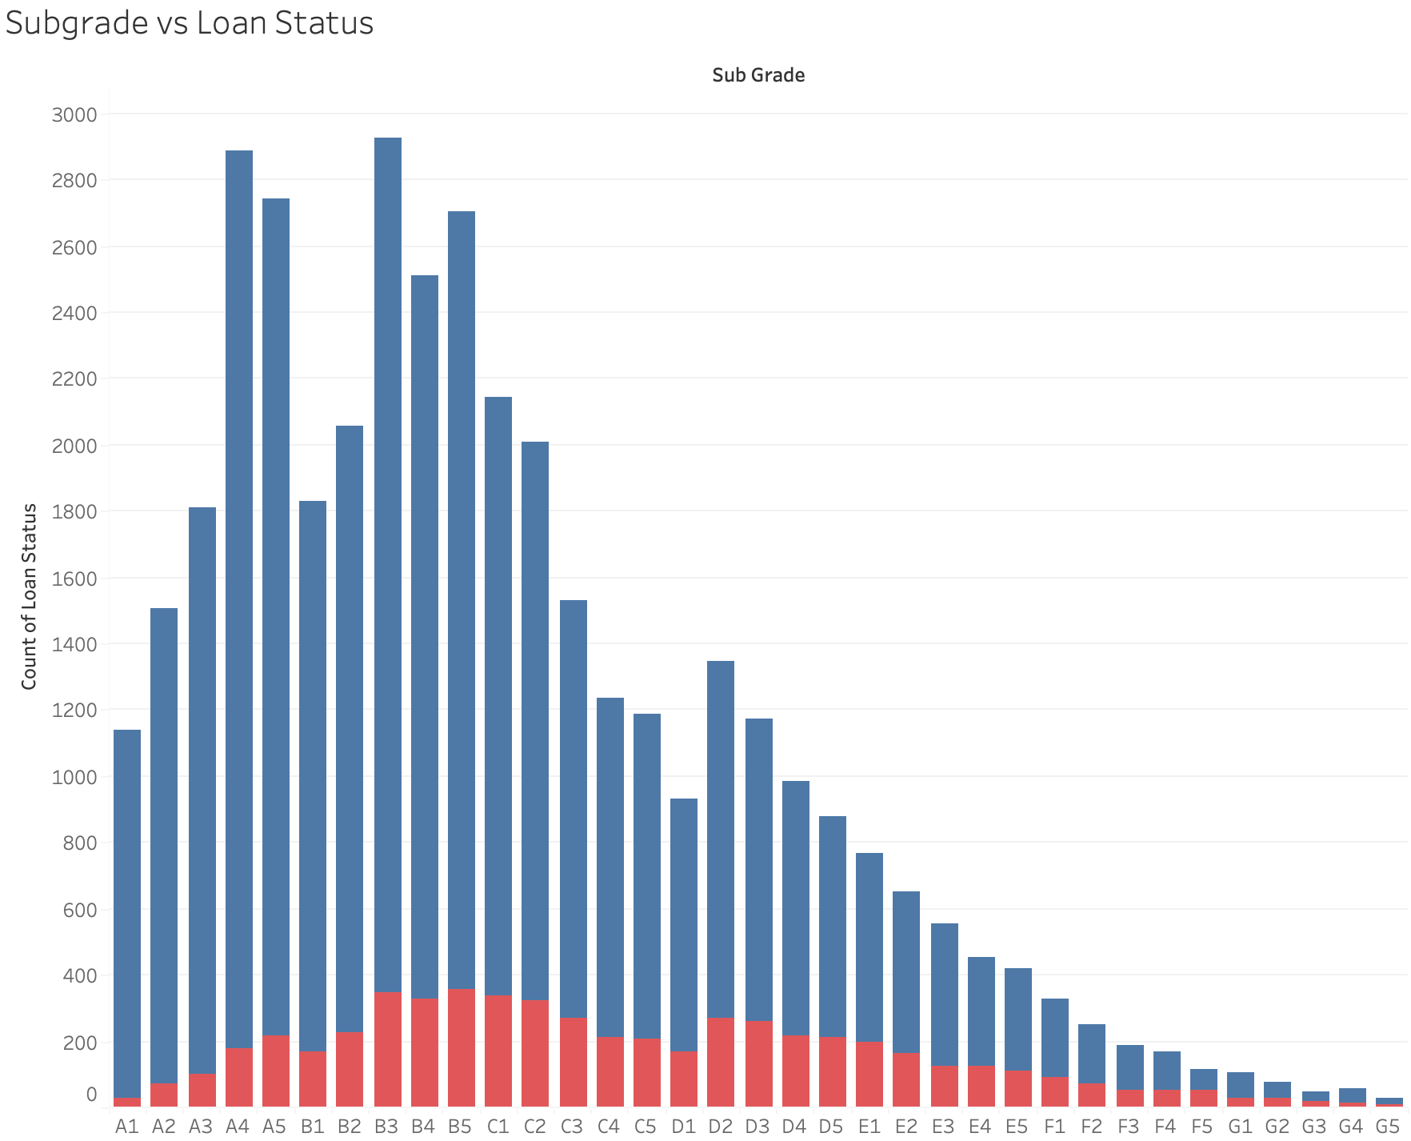
Default ratios
Notes:
Subgrades are formula that takes into account not only credit score, but also a combination of several indicators of credit risk. So essentially indicating the risk of a loan.
Therefore they make the borrower pay more interest to cover for potential loss. The higher the grade Letter the higher the rate a customer has to pay. This graph already shows us that class F and G have a big proportion of the defaulters. Let’s zoom in.

Slide 15
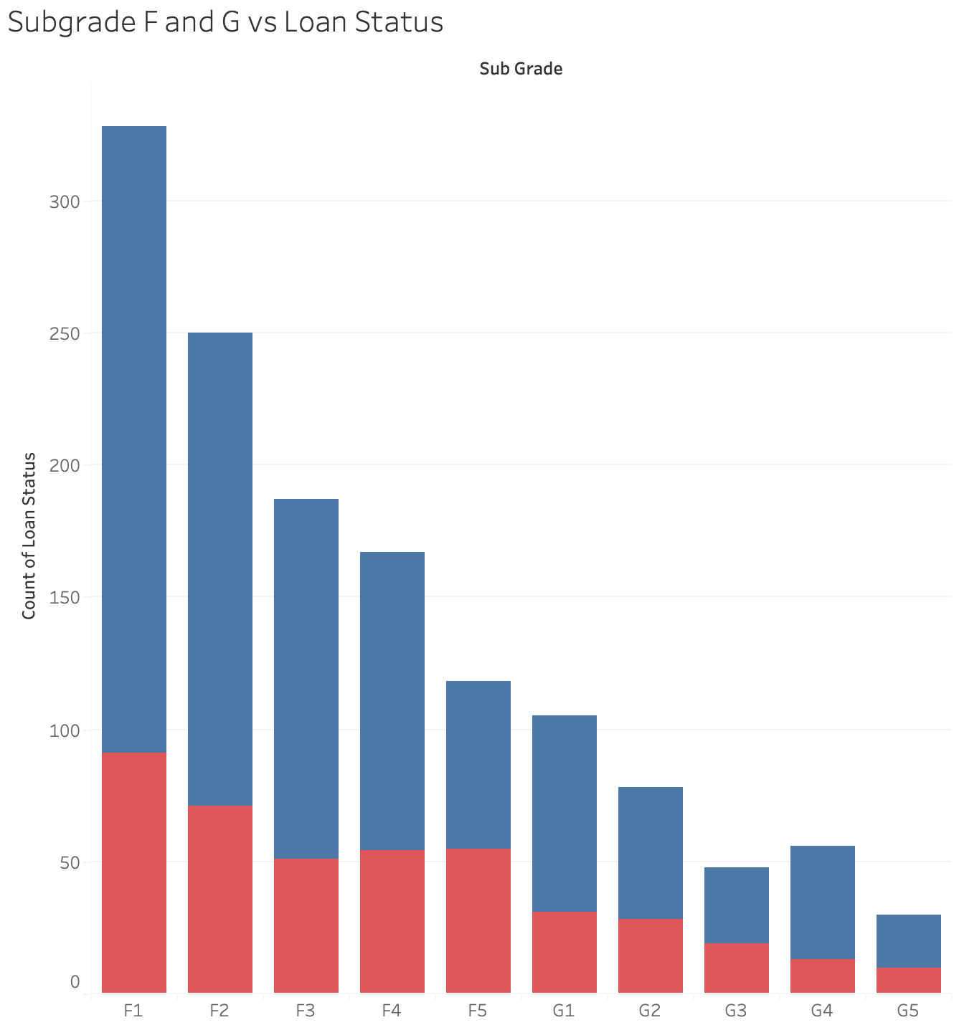
Default ratios
Notes:
As expected the ratio of defaulters here is high, so that means that LC’s risk assesing is working accordingly, and is an important influence on loan defaults.

Slide 16
Main takeaways
We can find defaulters in:
Small Business loans
Income lower than $70.000
Member with no mortgage, own nor rented house
Terms of 60 months
An interest rate above 12%
A subgrade within F and G
Notes:
So in summary, in the exploratory analysis we found that the following features have an influence on loan defaulters.

Slide 17
Predicting Defaults
Notes:
With this information in mind we can go about predicting the actual defaulters in our dataset.

Slide 18
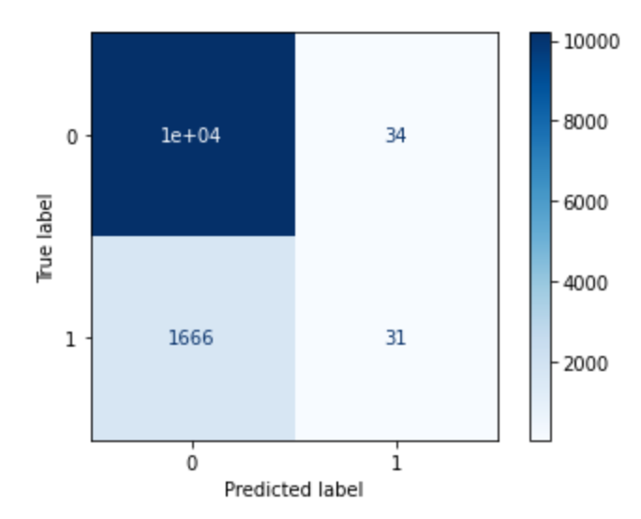
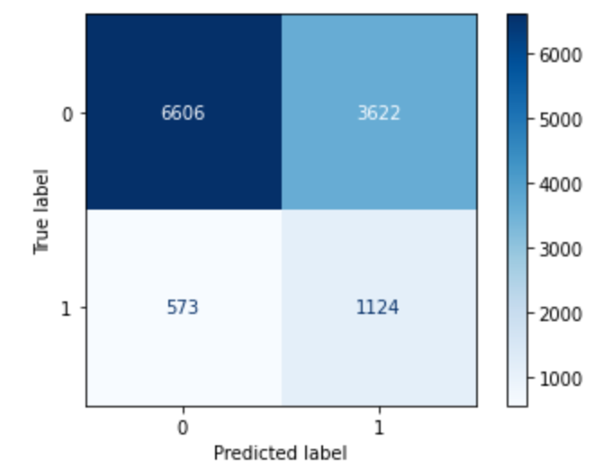
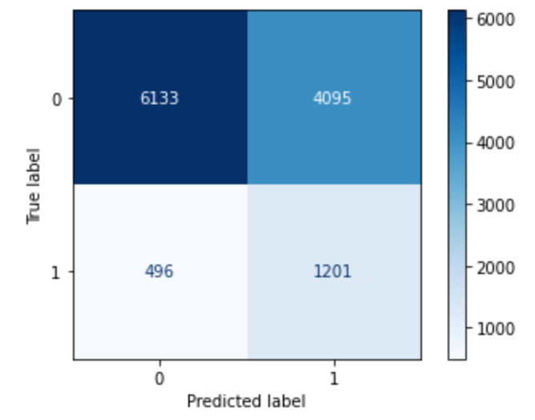
Model Evaluation
No Weights
Balanced Weights
Manual Weights
Notes:
To find the perfect prediction of loan defaulters I ran three different model. As we have already seen in the pie chart, the number of defaulters and paid off loans is heavily imbalanced. As the first model without weights shows in the red circle. It’s predicting that 1666 members will pay when they will actually default. We need this number to be as low as possible. By tweaking the weights, so evening out both values “default’ and ‘fully paid’ to deal with the imbalance, we can find different scores. As you can see we got the number of wrongly idetified payers down to 573, and with manual weights even to 496. Which is really good. However, let’s have a look at our top right block. This show the number of members that would’ve actually payed are predicted not to.
This is a big amount of loans to lose of course.
If I was actuallu in the company I would have used their metrics to calculate what the loss and gain of income is with every model is, however since I don’t have this I have to run with the info I have.
Based on this information, the last model is the best prediciton model as it minimizes the amount of defaulted loans while not losing the majority of loans.
I’ll explain why!
Balanced weights = automatically assigned weights based on the features to rule out the imbalance
manual weights = are to tweek the weights by yourself little by little to find that sweet spot.

Slide 19
Remember the risks?
No collateral
Loans are unsecured
Lower fixed rates
No Prepayment fees
Loss of personal funds
Multiple investors in one loan
Notes:
Let’s have another look at those risks.. By offering this to the LC members, LC has to be very certain that someone is not going to default. As there is not insurance or collatoral when someone doesn’t pay, also it’s very easy for new members to step in and have easy access to quick loans. But as discussed before, investors trust is everything for LC. Because no trust is no investors is no loans. Therefore we need to minimize the risk of defaulters as much as we can.
Luckily there is a way we don’t have to miss out on all those ‘good’ loans we are missing by being strict on defaulters.
As a matter of fact we have a great team of analysts at the LC that can execute other steps to build on the outcome of our model. let’s take a look

Slide 20
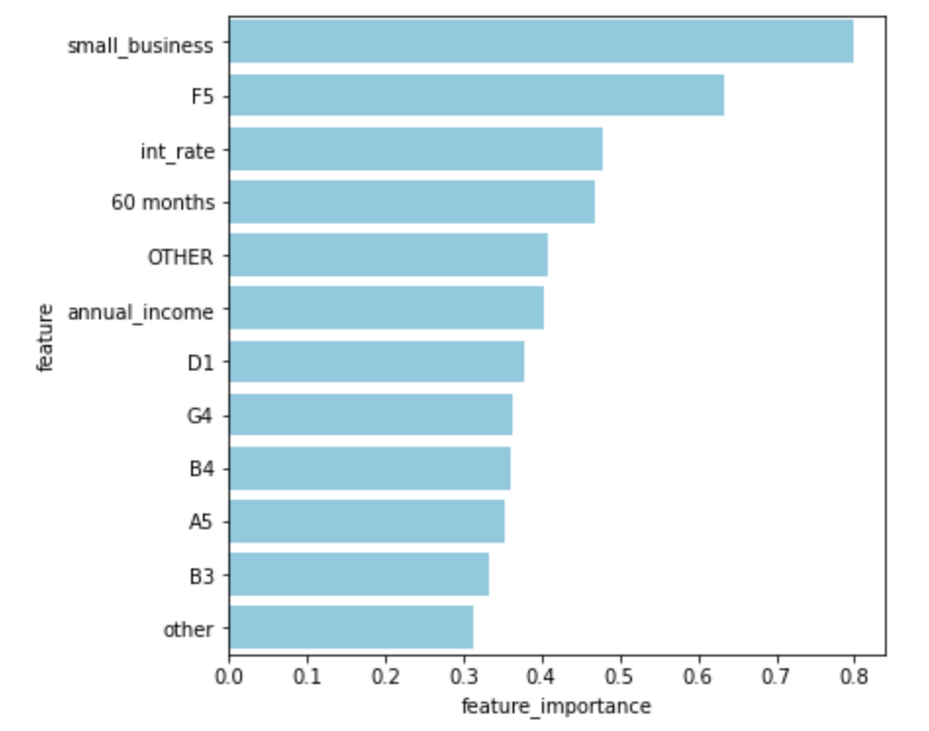
Feature Importance
How?
Use feature importance as an extra step
Reassess applicants
Split in default and potential non-defaulters
Notes:
Feature importance is a technique where you give a relative score to a feature in your model based on how useful they are on predicting a variable, in this case loan status. (Besides that it is also used to reduce the columns in your model and improve the scores) In Logistic regression the values > 0 are the ones that influence to outcome 1, in this case the actual defaulted loans. I’ve selected the top 12 features here, sorted on relevance, in order to improve the identification of loan defaulters.
As we can see the features are very similar to the ones we identified in our exploratotry analysis. Only the subgrades are different, suprsingly even. We find that lower subgrades such as A5 and D1 are also predictors of loan defaulters.
So how can we use this info to improve our model and miss as little as possible ‘good’ loans?

Slide 21
Conclusion
Notes:
With this information in mind we can go about predicting the actual defaulters in our dataset.

Slide 22
Conclusion
If an applicant applies for a loan and has the following features:
Small Business
Interest rate higher than 12%
Asks for a term of 60 months
Does not own a house, mortgage or rents a house
An income lower than $70.000
A purpose that is not classified under the known purpose values
Get’s classified for either a F5, D1, G4, B4, A5, or B3 grade
The change of a default is very high!
If they have none or little of these features, the change of a default is smaller.
Notes:
So we can conclude the following.

Slide 23
Next steps
Build a model to cross check applicants with important features
Develop a probability model that gives the change of non-default after cross check
Find out per customer what their ideal loan amount is
Notes:
Unfortunately I did not have enough time to build a model that does this cross checking. Which is what we can do in the next steps.
Just the presence of these features is not enough we should also have a look at the probabilty someone is going to default if they only has a few or none of these features.

